Slide 1
Internet from a MSX computer
Néstor Soriano (Konamiman)
http://www.konamiman.com
Notes:
Thanks for coming
Who am I
What I'm going to do (first, presentation; then, practical demonstration)

Slide 2

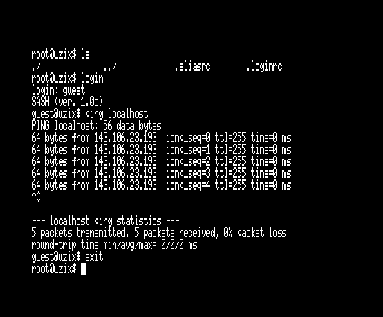
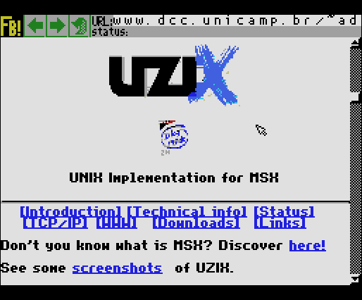
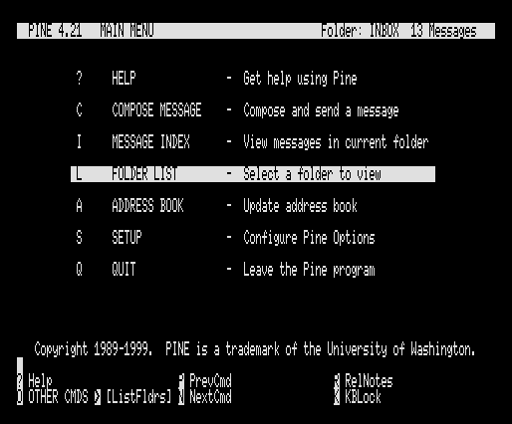
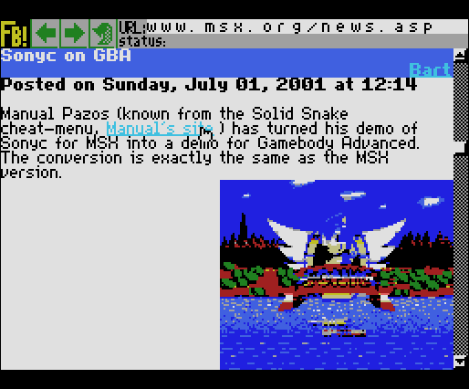
The pioneers: UZIX
Developed by Adriano C. R. da Cunha
Notes:
My software is not the first one that allows connecting a MSX to internet
Uzix, Unix implementation for MSX by A. Cunha.
About 1999
Web browser using a proxy server that simplifies HTML and images

Slide 3
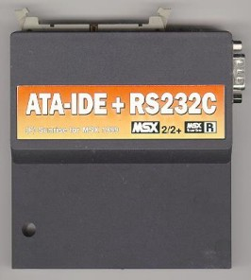
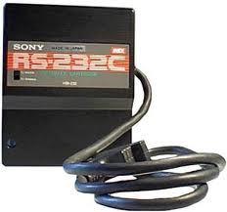
The InterNestor saga
2002: InterNestor Suite
Final project of telecommunication engineering
TCP/IP stack with modular design (exchangeable modules for hardware access, link level, network level and transport level)
Implemented modules: RS232, PPP, IP, TCP
64K for code + memory manager for data
Requires MSX with 256K RAM
Excessively slow
Notes:
It was 2001 and I was studying telecommunications engineering
I had to choose a project: internet for MSX
OSI model = Open Systems Interconnection

Slide 4
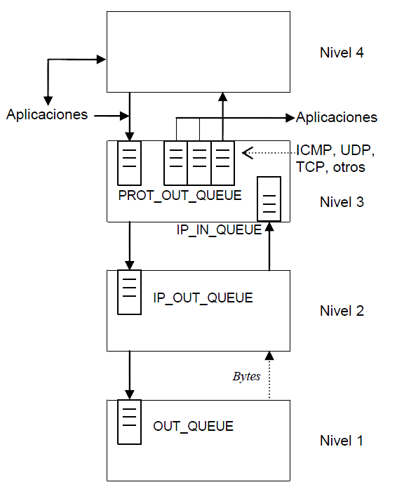
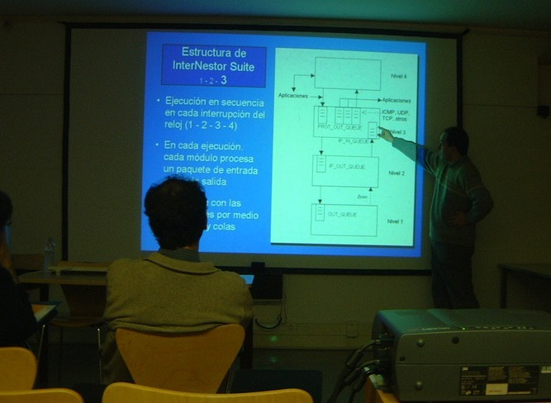
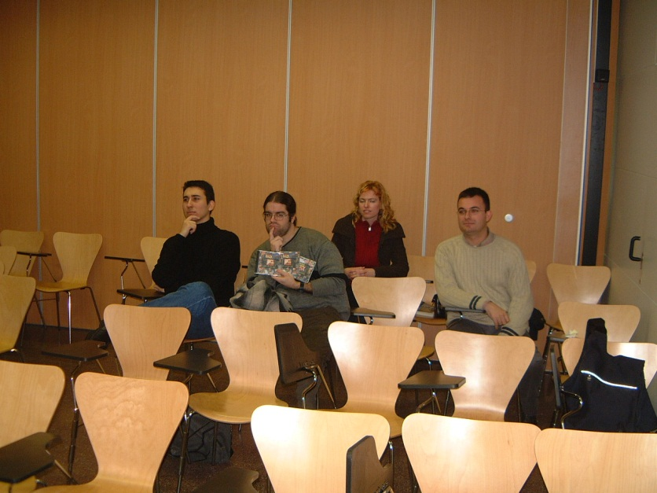

Slide 5
The InterNestor saga
2002: InterNestor Suite
2003: InterNestor Lite
Goal: reduce memory consumption and improve performance
16K for code + 16K for data
Targeting the same hardware as INS (RS232 + PPP)
API incompatible with INS

Slide 6
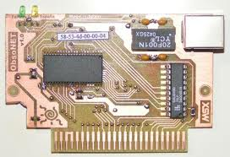
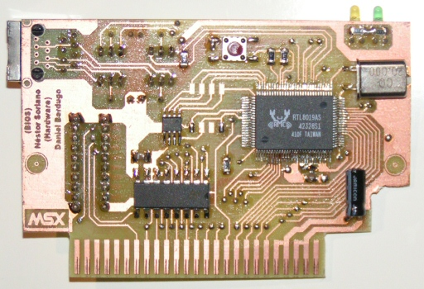
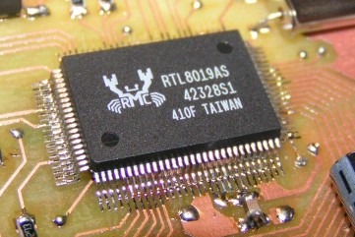
2004: ObsoNET
By Daniel Berdugo (hardware) & Néstor Soriano (BIOS)
Notes:
Handmade, about 30 units produced
I developed the BIOS (basic routines for hardware access, packet input/output, network state checking)
INL worked only with RS232

Slide 7
The InterNestor saga
2002: InterNestor Suite
2003: InterNestor Lite
2004: InterNestor Lite for ObsoNET
Built upon the code of INL of RS232
API compatible “enough” with INL for RS232 (compatible at the network and transport levels)

Slide 8

2007: UNAPI specification
Standard to define APIs for MSX
Defines a group of rules that APIs must follow:
API identifier + implementation name
One single entry point for all routines
Defines a procedure for discovering the installed API implementations
An API for Ethernet cards is defined initially
Notes:
I thought: what if someone else builds an ethernet card for MSX?
I'll create a standard for Ethernet APIs
But then I thought: better a standard for APIs

Slide 9
The InterNestor saga
2002: InterNestor Suite
2003: InterNestor Lite
2004: InterNestor Lite para ObsoNET
2007: InterNestor Lite for Ethernet UNAPI
Replaces INL for ObsoNET
Same API as INL for ObsoNET
ObsoNET BIOS 1.1 implements Ethernet UNAPI

Slide 10
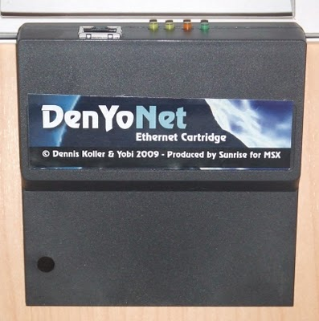
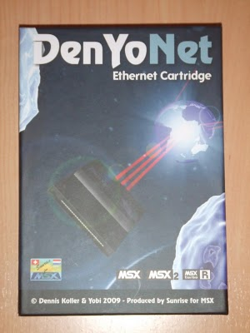
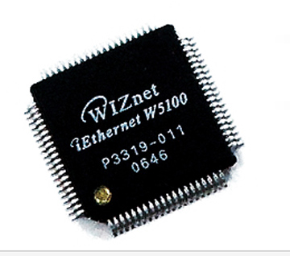
2009: DenYoNet
By Dennis Koller (DD) & Jos van den Biggelaar (Yobi)
Produced by Sunrise for MSX

Slide 11
The InterNestor saga
2002: InterNestor Suite
2003: InterNestor Lite
2004: InterNestor Lite para ObsoNET
2007: InterNestor Lite para Ethernet UNAPI
2010: TCP/IP UNAPI specification
+
InterNestor Lite 2
Two versions: for RS232 and for Ethernet UNAPI
Replaces INL 1
API incompatible with INL 1
Implements the API for TCP/IP UNAPI

Slide 12


Too many API changes!!
Sorry!

Slide 13
2009: DenYoNet
Two BIOS available:
BIOS compatible with Ethernet UNAPI
The W5100 is used as a simple Ethernet controller
To be used with InterNestor Lite 2 for Ethernet UNAPI
BIOS compatible with TCP/IP UNAPI (under development)
Uses the TCP/IP capabilities of the W5100
To be used directly, without InterNestor
In both cases the same client applications are used (they use the first available TCP/IP UNAPI implementation)

Slide 14
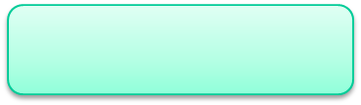
FTP, Telnet, e-mail...
API TCP/IP
INL for RS232
INL for Ethernet
API Ethernet
RS232 port
ObsoNET
DenYoNet (BIOS Ethernet)
DenYoNet (BIOS TCP/IP)

Slide 15


How does INL work?
There’s no multitask!
Update timers
Update state / Send one packet (DNS, DHCP)
Receive one packet
Update state / Send reply
Process one TCP connection
Send one segment
50/60 Hz
VDP MSX
Notes:
There's no multitask in MSX (Z80)
The MSX VDP generates interrupts with the same frequency as the screen refresh
INL captures the interrupt
The TCP connections are processed in each interrupt
Seen from far away, in a moonless night, and with dense fog, it remotely looks like cooperative multitasking

Slide 16
INL features What does fit in 16K+16K?
TCP: 4 connections (1K in + 1K out)
UDP: 3 connections (buffer for 1 packet)
Sends/receives PINGs (no data is stored)
DNS: Only resolves 1 name at the same time
DHCP for local IP, remote IP, gateway IP, network mask
ARP: table with 32 entries (dynamic and static)
Routing table: 16 entries

Slide 17
INL limitations What does NOT fit in 16K+16K?
NO datagrams >576 bytes
NO ICMP (except PING)
NO TIME-WAIT state for TCP
NO loopback address (127.x.x.x)
NO IP fragmentation
NO DNS cache
NO >9600 bauds (Z80) / >19200 bauds (R800)
Max theoretical speed: aprox. 30KByte/sec

Slide 18
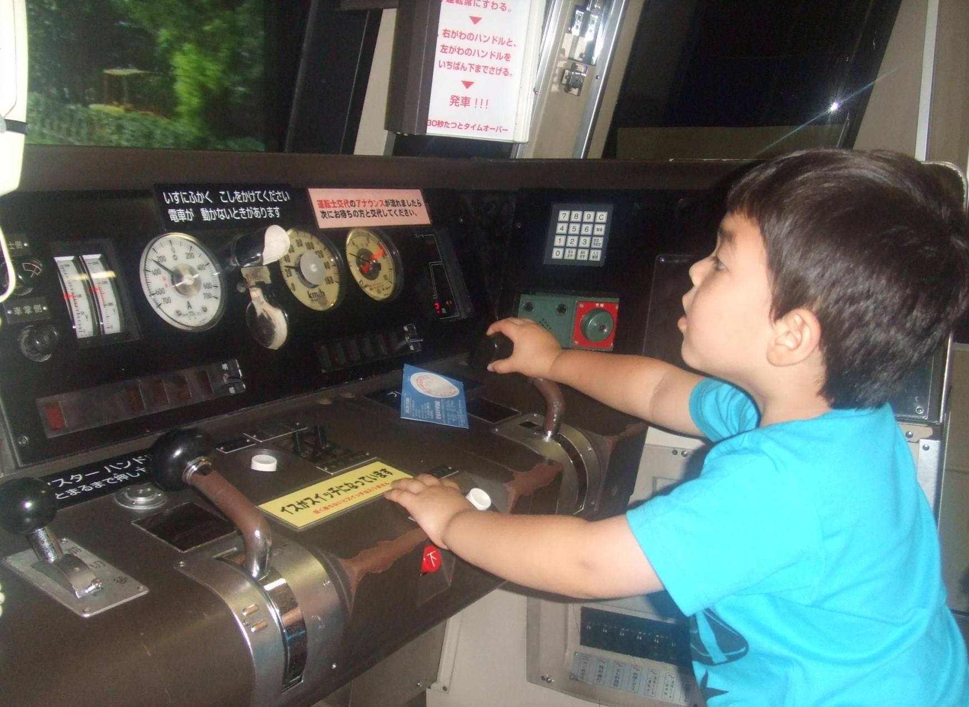
And now… let’s get some action!

